Slide 1

BOOTSTRAP Program Software Development Module Week 2

Slide 2
QUICK RECAP & ANNOUNCEMENT
Introduction
Assignment
Communication on Slack - #software-dev
Complete the project Survey Form
Notes:
Assignment on Github; Check the folder for the appropriate week.
Join the appropriate Channel

Slide 3
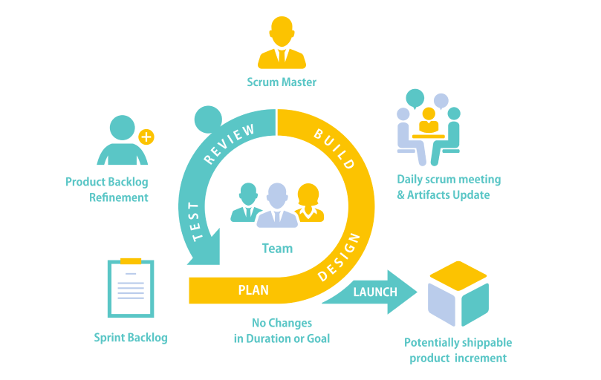
Software Development Process
Picture Credit: Techcronus

Slide 4

Software Development Process
Planning
Activities
Idea is born or pain point to resolve – Fill this week 1 form
Define your customers, understand Application Domain
Interview and Gather Requirements – Design Thinking
Analysis – Cost Benefit, SWOT
Tools
UML Diagrams – Behavioral Modeling (Activity and Use Case Diagram)
Activity per Persona
Use Case per Persona
For more Information See Tutorialspoints
Roles
Customers
Product Owner & Product Manager
Project and Program Manager
Notes:
Domain Understanding -
Cost Benefit – Use to determine profitability by comparing estimated future benefits against projected future costs.
UML – based on UML (Unified Modeling Language) . It is used for visually representing a system along with its main actors, roles, actions, artifacts or classes, in order to better understand, alter, maintain, or document information about the system.
Design – A method of Creative problem solving that involves:
* Ideation — Generating a lot of ideas. Brainstorming is one technique, but there are many others.
* Experimentation — Testing those ideas with prototyping.

Slide 5
Software Development Process
Design
Activities
UX – Sketches, Wireframes
Architectural Modelling– Technologies and Libraries to use
Database Modelling
Tools
UML Diagrams – Architectural Modeling
Class Diagram
ER Diagram
Sequence Diagram
For more Information See Tutorialspoints
Roles
Software Engineer, Test Engineers, Solution or Software Architect
Product Owners & Product Managers
Project Managers

Slide 6
Software Development Process
Build
Activities
Breakdown design is workable bits.
Choice of Data Structure & Algorithm
Coding and Testing
Tools
UML Diagrams – Architectural Modeling
Class Diagram
ER Diagram
For more Information See Tutorialspoints
Roles
Software Engineer & Test Engineers.
Devops Engineer.
Build and Release Engineer

Slide 7
Software Development Process
Review
Activities
Verification & Validation
Iterating through Protypes
Tools
Requirement Documents
Design Documents
Roles
Software Engineer & Test Engineers.
Product Owner, Product Manager, Project Manager

Slide 8
Software Development Process
Test
Activities
Test
Black box Testing
White Box Testing
Acceptance Testing
Tools
Technical Design Document
Requirement Document.
Roles
Software Engineer & Test Engineers.
Product Owner, Product Manager, Project Manager

Slide 9
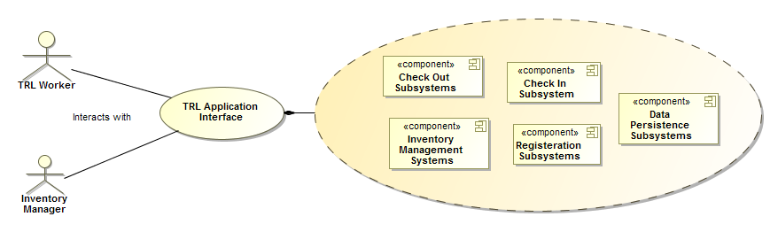
Use Case Diagram
Picture Credit: Gideon A. & Henry L, SEIS Class

Slide 10
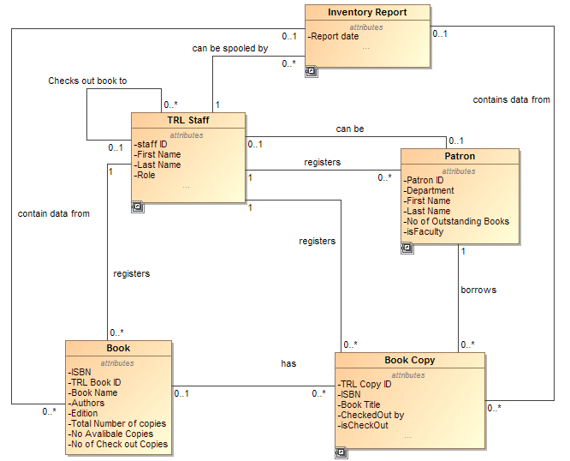
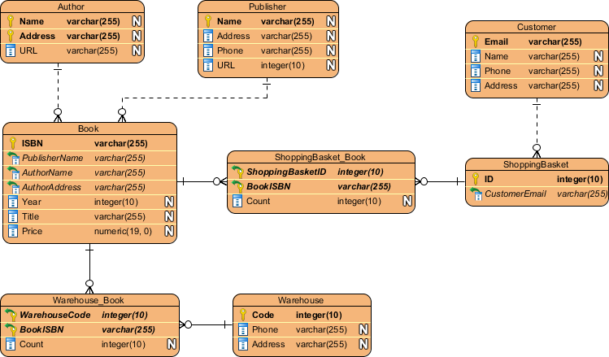
Entity Relationship (ER) Diagram
Picture Credit: Gideon A. & Henry L, SEIS Class
Picture Credit: Visual Paradigm

Slide 11
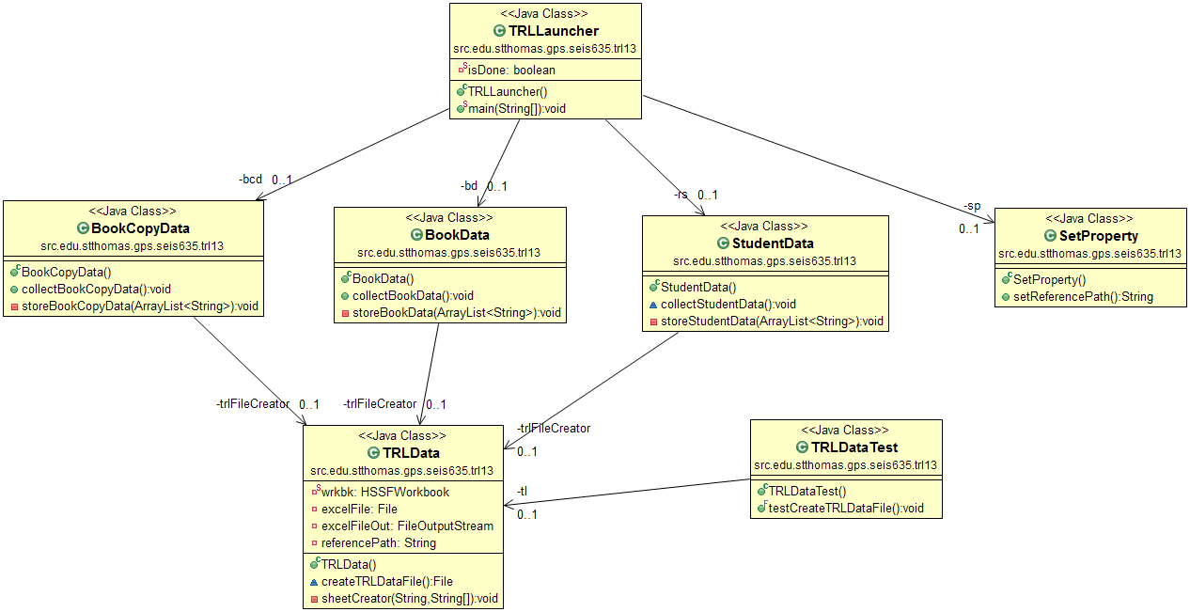
Class Diagram
Picture Credit: Gideon A. & Henry L, SEIS Class

Slide 12
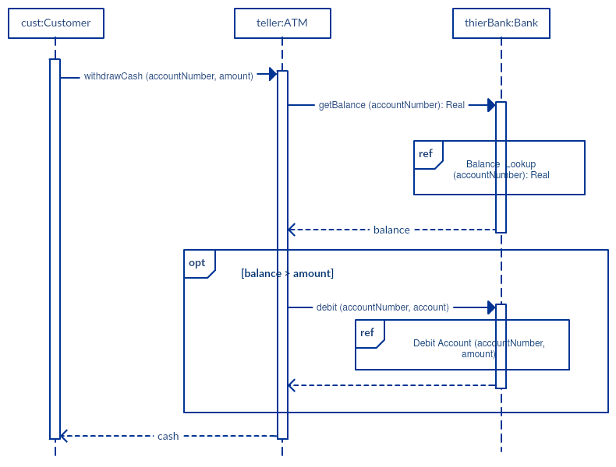
Sequence Diagram
Picture Credit: Creately

Slide 13
SUMMARY
Fluid Process
Iteration

Slide 14
HOUSE KEEPING
* Act as Product Owner Fill Out this form - https://forms.gle/DsAA2p1FmjRTex5TA

